Slide 1
DFC40243
SYSTEM ANALYSIS & DESIGN
TOPIC 5 SYSTEM IMPLEMENTATION AND SUPPORT

Slide 2
5.1 SYSTEM DEVELOPMENT

Slide 3
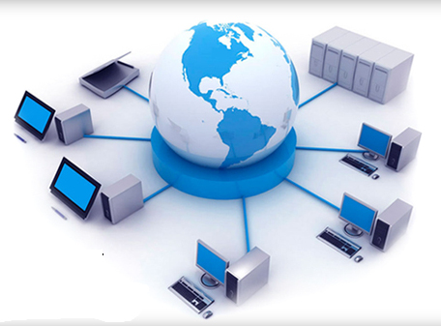
System Develoment Tools
1.Modeling
2.Prototyping
3.Computer-Aided Systems Engineering (CASE) Tools
Notes:
m/s 19

Slide 4
1. Modeling
Modeling produces a graphical representation of a concept or process that systems developers can analyze, test, and modify.
A systems analyst can describe and simplify an information system by using a set of business, data, object, network, and process models.

Slide 5
1. Modeling
A business model, or requirements model, describes the information that a system must provide.
A data model describes data structures and design.
An object model describes objects, which combine data and processes.
A network model describes the design and protocols of telecommunications links.
A process model describes the logic that programmers use to write code modules.
Although the models might appear to overlap, they actually work together to describe the same environment from different points of view.

Slide 6
2. Prototyping
Prototyping tests system concepts and provides an opportunity to examine input, output, and user interfaces before final decisions are made.
A prototype is an early working version of an information system.
A prototype can serve as an initial model that is used as a benchmark to evaluate the finished system, or the prototype itself can develop into the final version of the system.

Slide 7
2. Prototyping
A possible disadvantage of prototyping is that important decisions might be made too early, before business or IT issues are understood thoroughly.
A prototype based on careful fact-finding and modeling techniques, however, can be an extremely valuable tool.

Slide 8
3.Computer-Aided Systems Engineering (CASE) Tools
Computer-aided software engineering, is a technique that uses powerful software, called CASE tools, to help systems analysts develop and maintain information systems.
CASE tools provide an overall framework for systems development and support a wide variety of design methodologies, including structured analysis and object-oriented analysis.

Slide 9
3.Computer-Aided Systems Engineering (CASE) Tools
CASE tools make it easier to build an information system, they boost IT productivity and improve the quality of the finished product.
After developing a model, many CASE tools can generate program code, which speeds the implementation process.

Slide 10
Coding Process
Coding is the process of turning program logic into specific instructions that the computer system can execute.
Working from a specific design, a programmer uses a programming language to transform program logic into code statements.
An individual programmer might create a small program, while larger programs typically are divided into modules that several individuals or groups can work on simultaneously.
Notes:
m/s 523

Slide 11
5.2 TESTING IN A PROJECT
Notes:
m/s 508

Slide 12
Software Quality Assurance
Software quality assurance (SQA) is a process that ensures that developed software meets and complies with defined or standardized quality specifications.
SQA is an ongoing process within the software development life cycle (SDLC) that routinely checks the developed software to ensure it meets desired quality measures.

Slide 13
The importance of software quality assurance.
The main objective of quality assurance is to avoid problems or to identify them as soon as possible.
Poor quality can result from inaccurate requirements, design problems, coding errors, faulty documentation, and ineffective testing.
To improve the finished product, software systems developers should consider software engineering and internationally recognized quality standards.

Slide 14
Testing the system
After coding, a programmer must test each program to make sure it functions correctly.
Later, programs are tested in groups, and finally the development team must test the entire system.
Unit Testing
Integration Testing
System testing

Slide 15
Unit Testing
The testing of an individual program or module.
The objective is to identify and eliminate execution errors that could cause the program to terminate abnormally, and logic errors that could have been missed during desk checking.
During unit testing, programmers must test programs that interact with other programs and files individually, before they are integrated into the system (techniques called stub testing).

Slide 16
Unit Testing
Desk checking is the process of reviewing the program code to spot logic errors, which produce incorrect results.
This process can be performed by the person who wrote the program or by other programmers

Slide 17
Integration Testing
Testing two or more programs that depend on each other.
Testing the programs independently does not guarantee that the data passed between them is correct.
Only by performing integration testing for this pair of programs can you make sure that the programs work together properly

Slide 18
System Testing
System testing involves the entire information system.
A system test includes all typical processing situations and is intended to assure users, developers, and managers that the program meets all specifications and that all necessary features have been included.

Slide 19
System Testing
During a system test, users enter data, including samples of actual, or live, data, perform queries, and produce reports to simulate actual operating conditions.
All processing options and outputs are verified by users and the IT project development team to ensure that the system functions correctly.

Slide 20
Documentation
Documentation describes an information system and helps the users, managers, and IT staff who must interact with it.
Accurate documentation can reduce system downtime, cut costs, and speed up maintenance tasks.
Documentation is essential for successful system operation and maintenance

Slide 21
Program Documentation
Describes the inputs, outputs, and processing logic for all program modules.
The program documentation process starts in the systems analysis phase and continues during systems implementation.
Systems analysts prepare overall documentation, such as process descriptions and report layouts, early in the SDLC.
This documentation guides programmers, who construct modules that are well supported by internal and external comments and descriptions that can be understood and maintained easily.

Slide 22
System Documentation
Describes the system’s functions and how they are implemented.
System documentation includes data dictionary entries, data flow diagrams, object models, screen layouts, source documents, and the systems request that initiated the project.
System documentation is necessary reference material for the programmers and analysts who must support and maintain the system.
Most of the system documentation is prepared during the systems analysis and systems design phases.

Slide 23
Operation Documentation
Contains all the information needed for processing and distributing online and printed output.
operations documentation includes the
Contains following information:
Program, systems analyst, programmer, and system identification
Scheduling information for printed output, such as report run frequency and Deadlines
Input files and where they originate; and output files and destinations
E-mail and report distribution lists
Special forms required, including online forms
Error and informational messages to operators and restart procedures
Special instructions, such as security requirements

Slide 24
User Documentation
Consists of instructions and information to users who will interact with the system and includes user manuals, Help screens, and tutorials
User documentation includes the following:
A system overview that clearly describes all major system features, capabilities, and limitations
Description of source document content, preparation, processing, and samples
Overview of menu and data entry screen options, contents, and processing instructions
Examples of reports that are produced regularly or available at the user’s request, including samples
Security and audit trail information
Explanation of responsibility for specific input, output, or processing requirements
Procedures for requesting changes and reporting problems

Slide 25
Documentation
Program Documentation
Describes the inputs, outputs, and processing logic for all program modules.
System Documentation
Describes the system’s functions and how they are implemented.
Operation Documentation
Contains all the information needed for processing and distributing online and printed output.
User Documentation
The program documentation process starts in the systems analysis phase and continues during systems implementation.
System documentation includes data dictionary entries, data flow diagrams, object models, screen layouts, source documents, and the systems request that initiated the project.
Consists of instructions and information to users who will interact with the system and includes user manuals, Help screens, and tutorials.

Slide 26
5.3 SYSTEM IMPLEMENTATION
Notes:
m/s 508

Slide 27
Steps in System Implementation
Prepare a separate operational and test environment
Carry out a post-implementation evaluation of the system
Present a final report to management
Provide training for users, managers, and IT staff
Perform data conversion and system changeover

Slide 28
System Installation
Installation of a system is the act of making the program ready for execution. Because the process varies for each program and each computer, system often come with an installer, a specialized program responsible for doing whatever is needed for their installation.
Installation may be part of a larger software deployment process

Slide 29
System Evaluation
System evaluation is an ongoing process throughout the performance testing effort, it offers greater value when conducted early in the test project.
The intent of system evaluation is to collect information about the project as a whole, the functions of the system, the expected user activities, the system architecture, and any other details that are helpful in guiding performance testing to achieve the specific needs of the project.

Slide 30
5.4 SYSTEM SUPPORT AND SECURITY
Notes:
m/s 508

Slide 31
System Support and Security
The systems support and security phase begins when a system becomes operational and continues until the system reaches the end of its useful life.
Throughout the development process, the objective has been to create an information system that is efficient, easy to use, and affordable.
After delivering the system, the IT team focuses on support and maintenance tasks.

Slide 32
User Support
Companies provide user support in many forms, including user training and a help desk to provide technical support and assistance.
User Training
Help Desk

Slide 33
User Training
A successful information system requires training for users, managers, and IT staff members.
The entire systems development effort can depend on whether or not people understand the system and know how to use it effectively.
The main objective is to show users how the system can help them perform their jobs.
Training users about system changes is similar to initial training.

Slide 34
Help Desk
A help desk is a centralized resource staffed by IT professionals who provide users with the support they need to do their jobs.
A help desk has three main objectives:
Show people how to use system resources more effectively,
provide answers to technical or operational questions, and
make users more productive by teaching them how to meet their own information needs.
A help desk often is called an information center (IC) because it is the first place users turn when they need information or assistance.

Slide 35
Maintenance
Maintenance expenses vary significantly during the system’s operational life and include spending to support maintenance activities.
Maintenance activities include changing programs, procedures, or documentation to ensure correct system performance; adapting the system to changing requirements; and making the system operate more efficiently.
Those needs are met by corrective, adaptive, perfective, and preventive maintenance.

Slide 36
Corrective Maintenance
Corrective maintenance diagnoses and corrects errors in an operational system.
To avoid introducing new problems, all maintenance work requires careful analysis before making changes.

Slide 37
Adaptive Maintenance
Adaptive maintenance adds enhancements to an operational system and makes the system easier to use.
An enhancement is a new feature or capability.
The need for adaptive maintenance usually arises from business environment changes such as new products or services, new manufacturing technology, or support for a new Web-based operation.

Slide 38
Perfective Maintenance
Perfective maintenance involves changing an operational system to make it more efficient, reliable, or maintainable.
Perfective maintenance project could improve response time and system efficiency.
Perfective maintenance usually is cost effective during the middle of the system’s operational life.

Slide 39
Preventive Maintenance
To avoid problems, preventive maintenance requires analysis of areas where trouble is likely to occur.
Preventive maintenance often results in increased user satisfaction, decreased downtime, and reduced TCO.
Preventive maintenance competes for IT resources along with other projects, and sometimes does not receive the high priority that it deserves

Slide 40
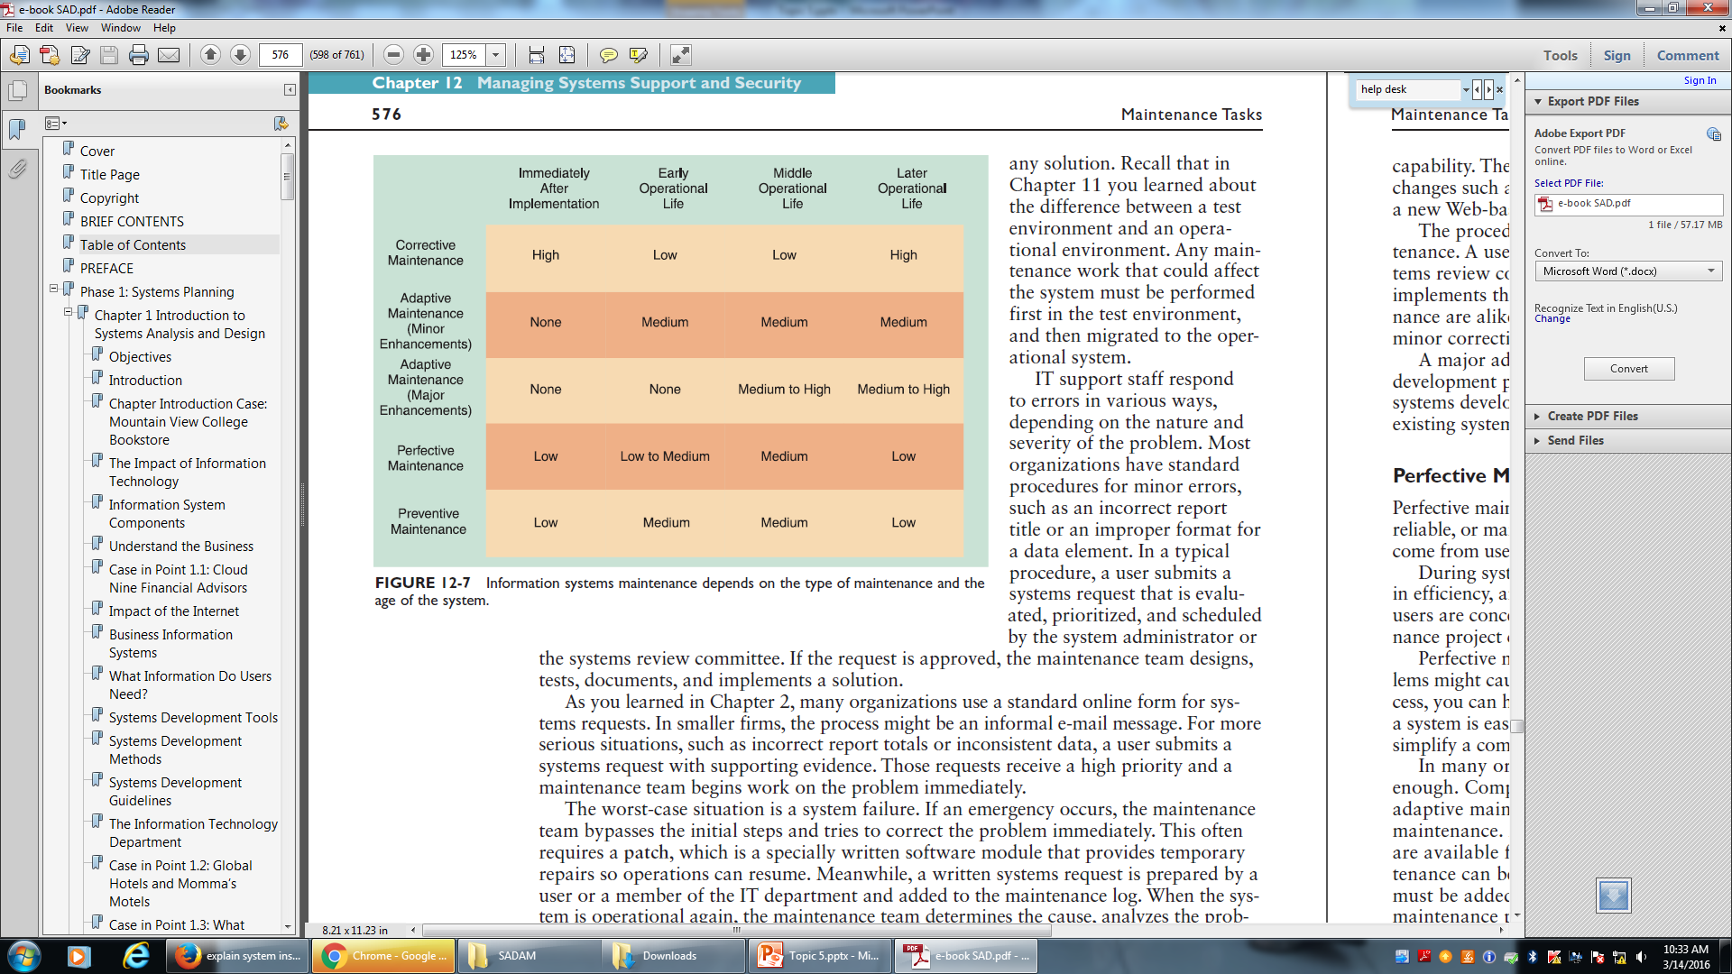
Maintenance

Slide 41
System Maintenance Tools
Many CASE tools include system evaluation and maintenance features, including the following examples:
Performance monitor that provides data on program execution times
Program analyzer that scans source code, provides data element cross-reference information, and helps evaluate the impact of a program change
Interactive debugging analyzer that locates the source of a programming error
Reengineering tools
Automated documentation
Network activity monitor
Workload forecasting tool
Notes:
m/s 588

Slide 42
System Maintenance Tools
In addition to CASE tools, you also can use spreadsheet and presentation software to calculate trends, perform what-if analyses, and create attractive charts and graphs to display the results.
Notes:
m/s 588

Slide 43
System Security
Security protects the system, and keeps it safe, free from danger, and reliable.
In a global environment that includes many types of threats and attacks, security is more important than ever.

Slide 44
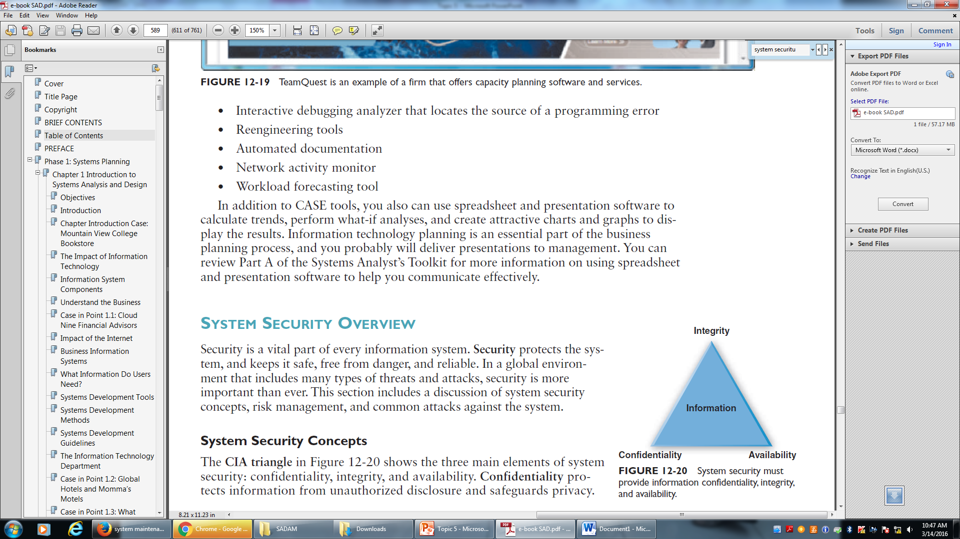
Elements of System Security
Three main elements of system security: confidentiality, integrity, and availability.

Slide 45
Elements of System Security
Confidentiality protects information from unauthorized disclosure and safeguards privacy.
Integrity prevents unauthorized users from creating, modifying, or deleting information.
Availability ensures that authorized users have timely and reliable access to necessary information.

Slide 46
Backup
Backup refers to copying data at prescribed intervals, or continuously.
Recovery involves restoring the data and restarting the system after an interruption.
An overall backup and recovery plan that prepares for a potential disaster is called a disaster recovery plan.

